Slide 1
Properties of Matter
Chapter 4
Outline
More Properties of Matter
Physical
Chemical
Law of Conservation of Mass
Energy
Law of Conservation of Energy
Heat
Specific Heat
Energy and Nutrition

Slide 2
Example – Physical and Chemical Properties
Alka-Seltzer tablets form bubbles in water. Is a
A. physical property.
B. chemical property.

Slide 3
Example – Physical and Chemical Change
Grinding aspirin tablets to a fine powder is a
A. physical change.
B. chemical change.

Slide 4
Example – Physical and Chemical Change
Dissolving salt in water is a
A. physical change.
B. chemical change.

Slide 5
Which are chemical or physical changes?
Mulching leaves
Milk turning sour
Making wine
Making ice water
Beer going flat
Leaves changing color

Slide 6
Example – Law of Conservation of Mass
If 10.0 g of calcium carbonate, CaCO₃, is decomposed by heating to 5.6 g of calcium oxide, CaO, and carbon dioxide, CO₂. How many grams of carbon dioxide gas are evolved?
heat
CaCO_{3 (s)} → CaO _{(s)} + CO_{2 (g)}

Slide 7
What is specific heat?
Some specific heat values:
water 1.0 cal/g ºC or 4.184 J/g ºC
Al 0.216 cal/g ºC or 0.902 J/g ºC
Cu 0.092 cal/g ºC or 0.385 J/g ºC
Fe 0.113 cal/g ºC or 0.473 J/g ºC
Au 0.031 cal/g ºC or 0.131 J/g ºC

Slide 8
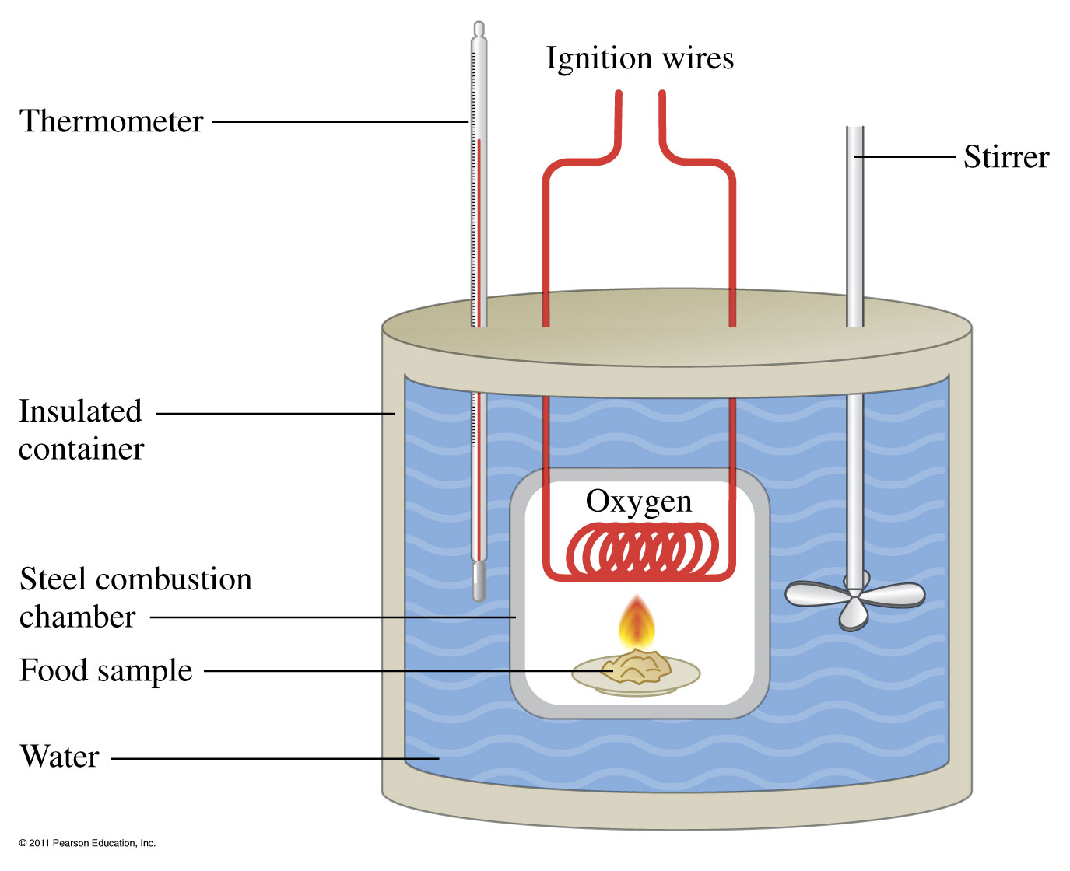
How is the energy of food measured?

Slide 9
Example - Heat
If one stalk of celery heats 505 g of water from 25.2 °C to 35.7 °C in a calorimeter, how many kilocalories were in the unburned (uncombusted) celery? C_{water} = 4.184 J/g °C

Slide 10
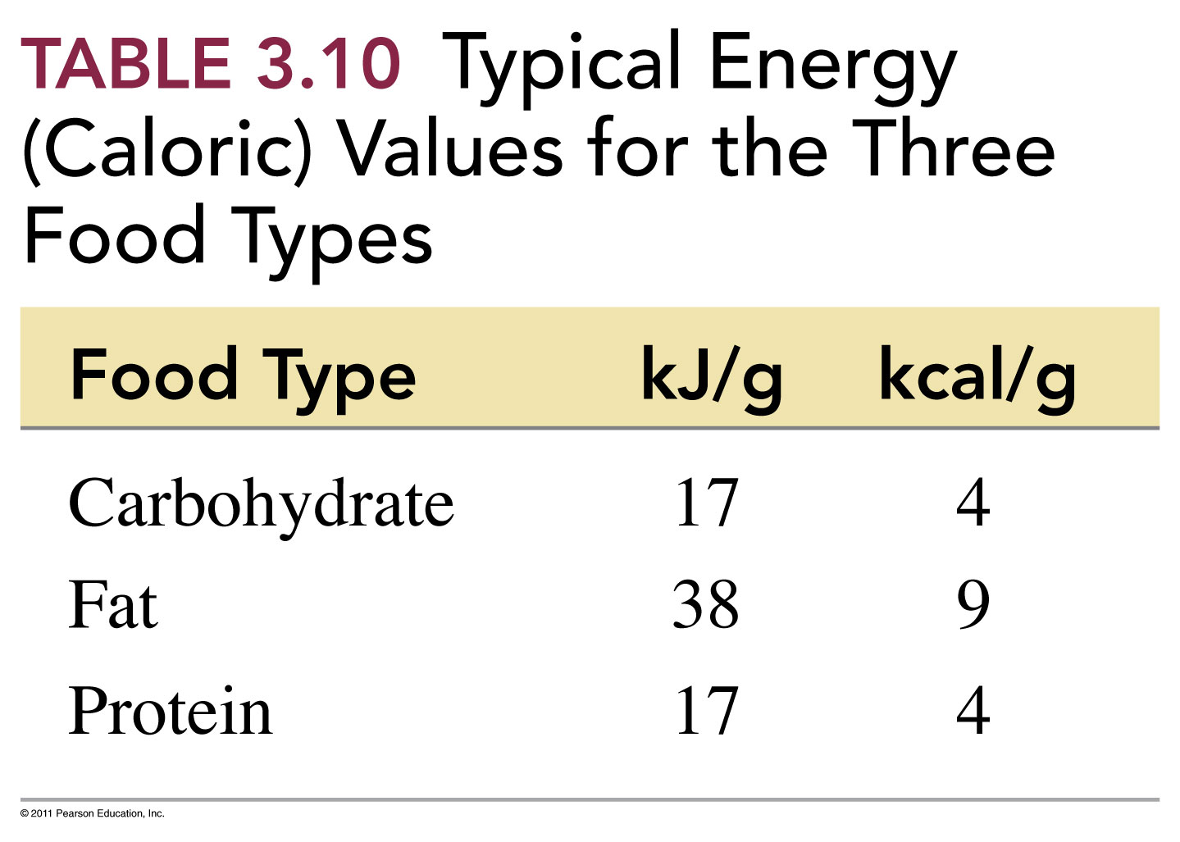

Slide 11
Example – Energy and Food
How many kilocalories will you get from eating one slice of pizza?

Slide 12
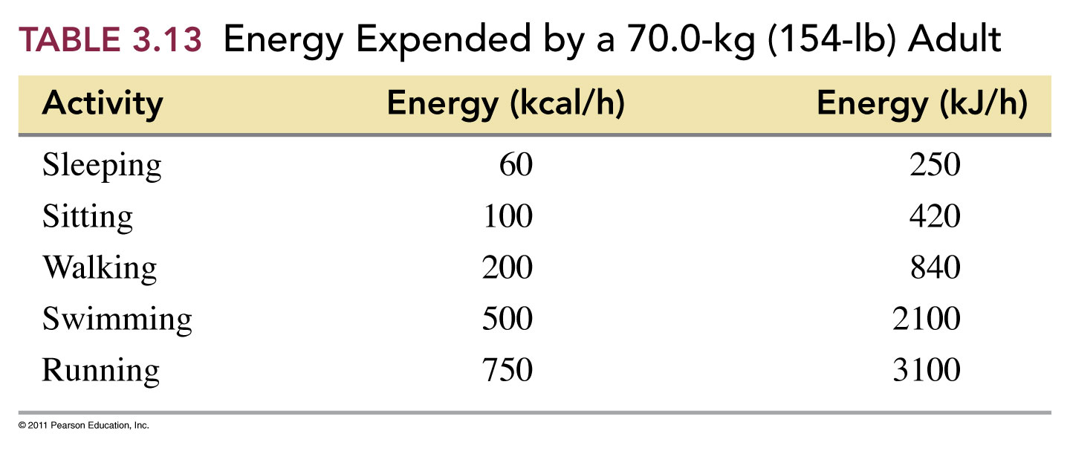
Example – Energy and Food
How long must you swim to use up the energy that you get from a piece of pizza?

Slide 13
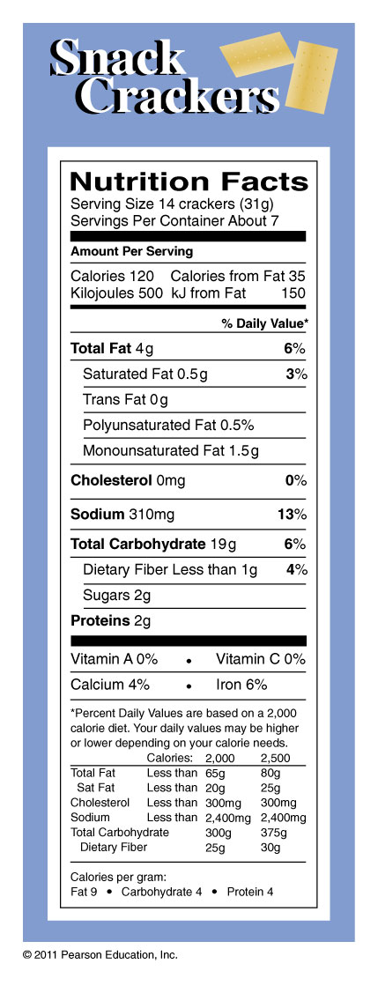
Does the calories from fat make sense?

